Slide 1
Nutrients and agriculture

Slide 2
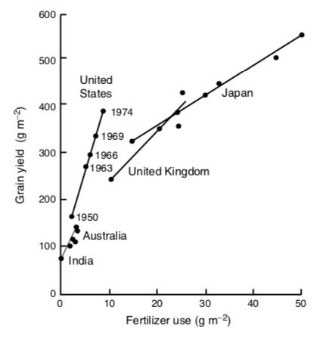

Slide 3
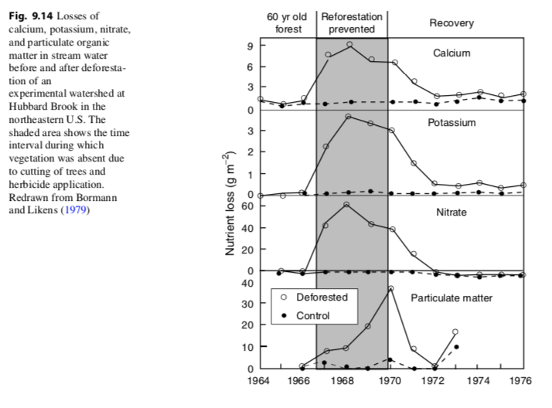

Slide 4
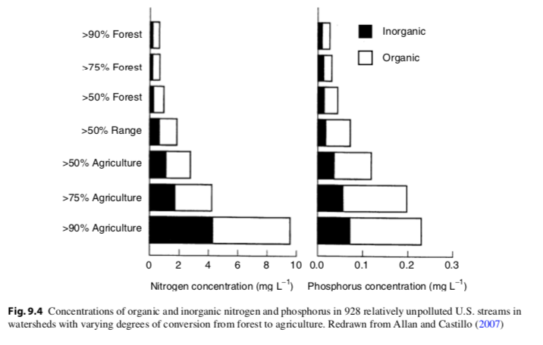

Slide 5
Yield Gaps
Mueller ND, Gerber JS, Johnston M, Ray DK, Ramankutty N, Foley JA. 2012. Closing yield gaps through nutrient and water management. Nature 490: 254.

Slide 6
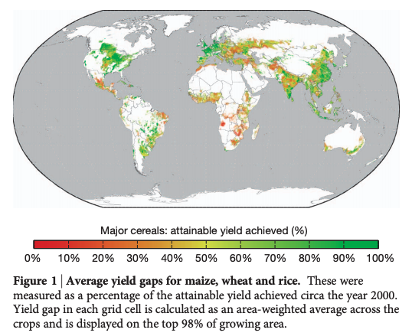
Only some areas obtain max yield

Slide 7
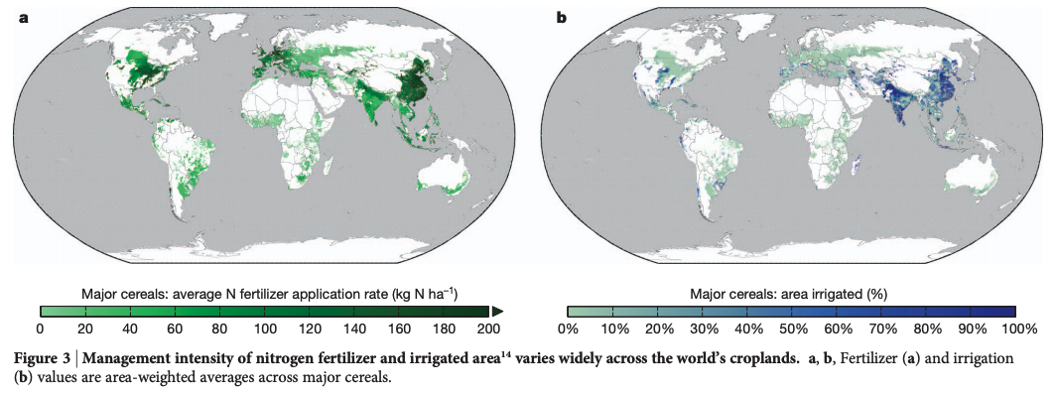
But it takes a lot of resources to get there

Slide 8
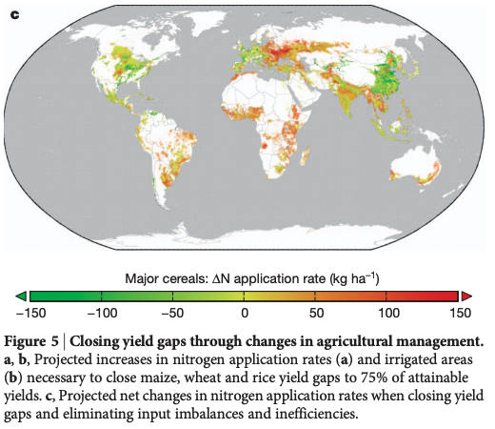
(green areas are using more nutrients than necessary)

Slide 9
What might be the ecosystem impacts of fertilizer use?

Slide 10
From agriculture and fossil fuel burning
NOAA

Slide 11
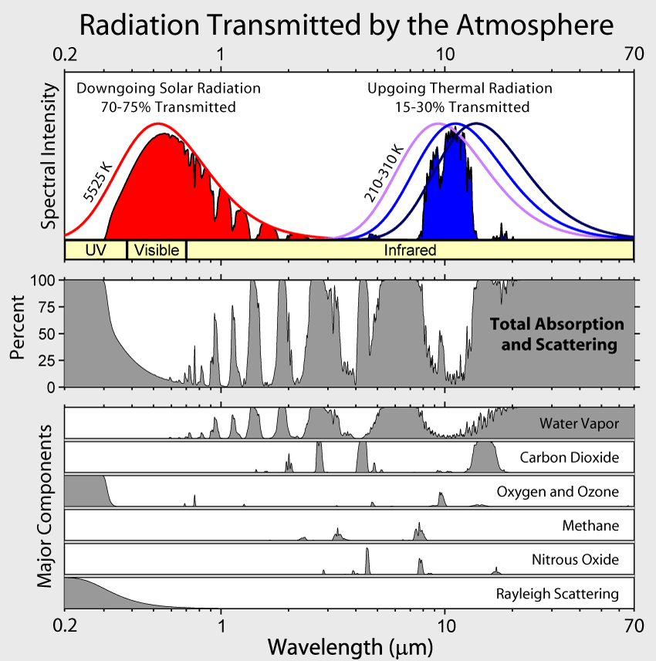

Slide 13
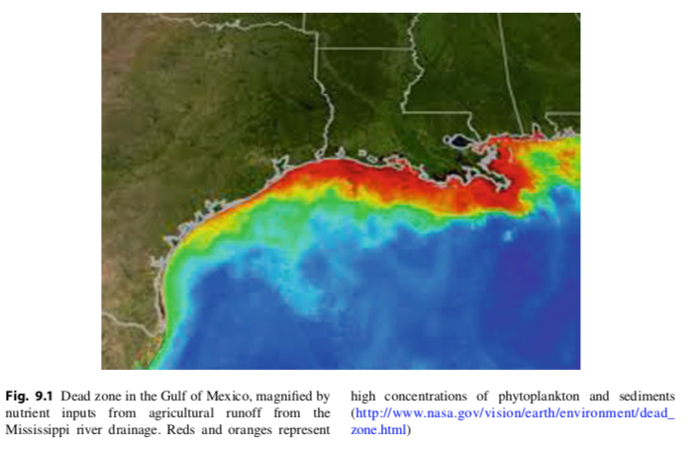

Slide 14
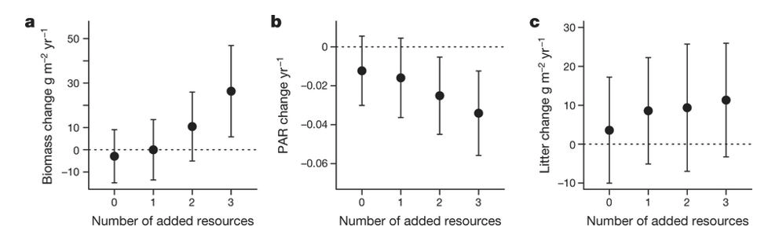
Harpole et al. (2016)

Slide 15
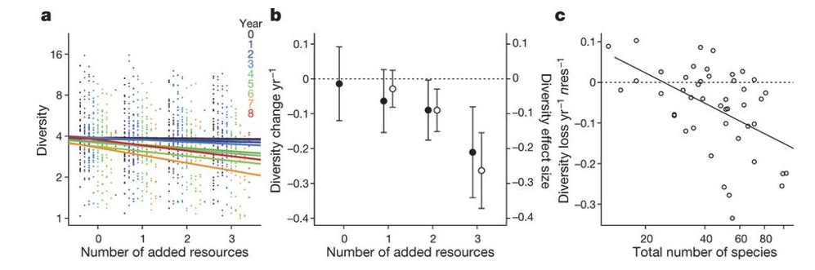
Harpole et al. (2016)

Slide 16
How do we avoid these?

Slide 17
Increased efficiency could reduce N and P use by 28% and 38% globally

Slide 18
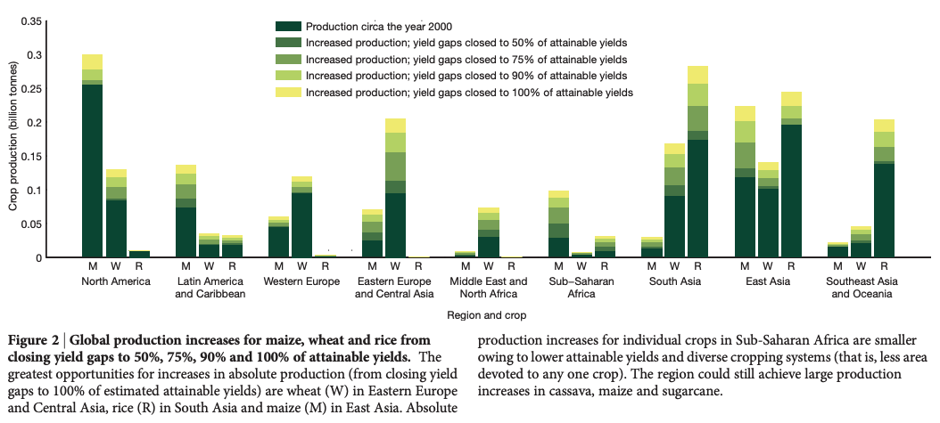
Closing yield gap requires more input (in some place), but mostly better management

